Slide 1
Udacity self driving car engineer Nanodegree- 1-Computer Vision
Document created by – Poluri Nikhil Koundinya
OBJECT DETECTION IN IMAGES

Slide 2
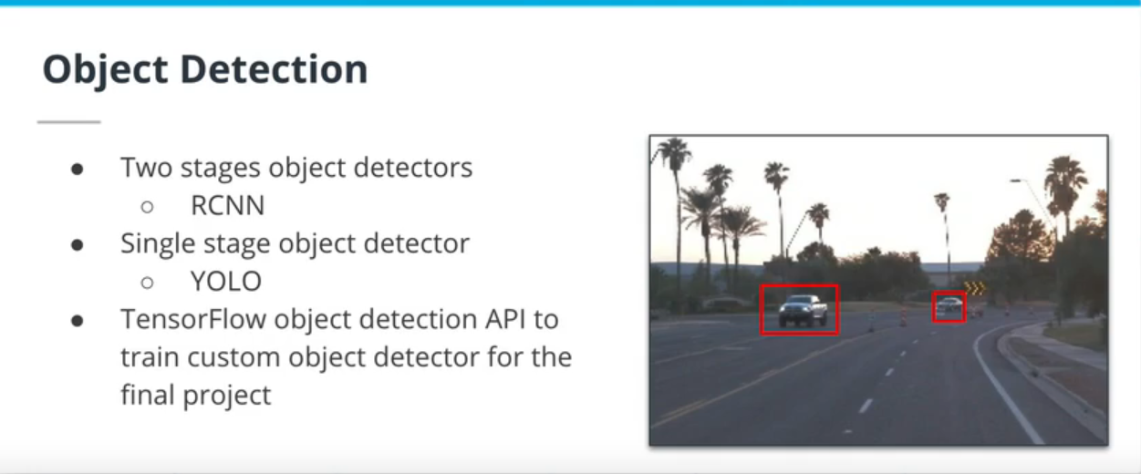
In this lesson, we will tackle:
An overview of object detection algorithms
A post processing method for detections
A new metric: mean average precision (mAP)
The TensorFlow object detection API
Tips and tricks to train and monitor neural networks

Slide 3
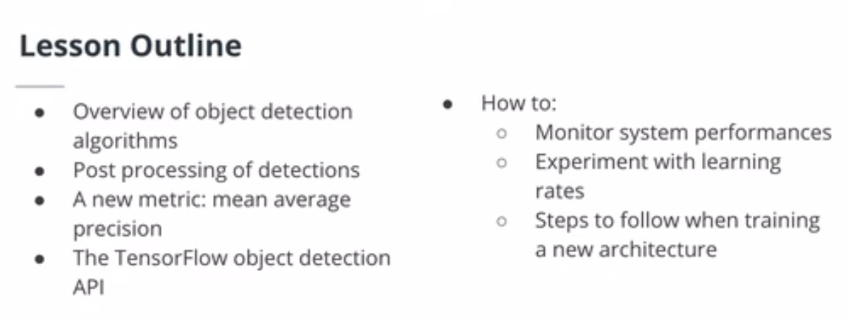
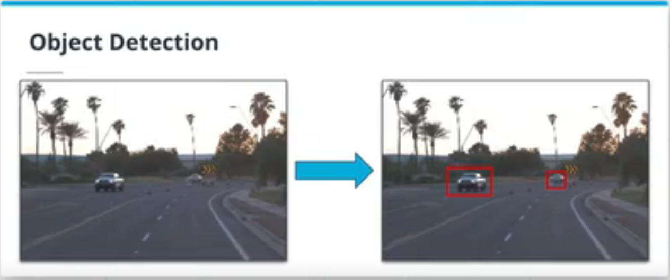
Big Picture

Slide 4
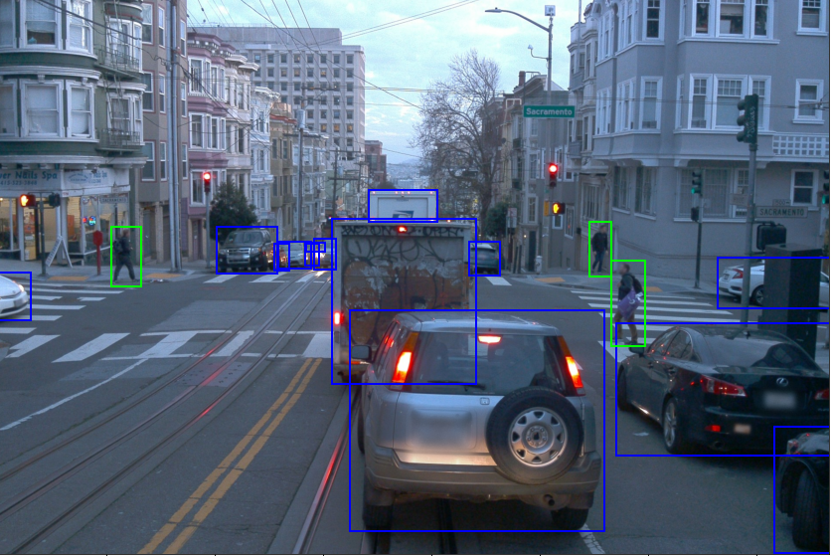
Let's look at the image above. We can quickly understand why image classification is not the way to go to fully understand the environment - there are multiple objects of multiple classes. We need an object detection algorithm here, where each object in the image is located and classified.

Slide 5
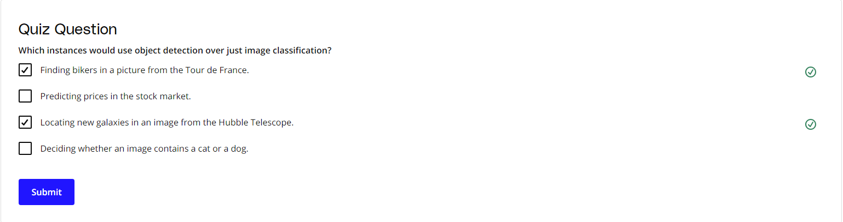

Slide 6
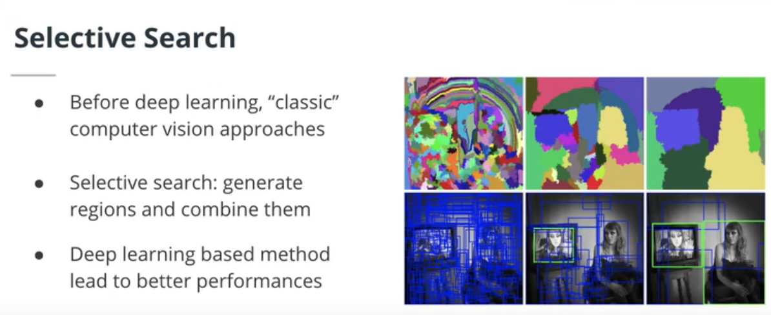
Region-Based CNNs (RCNNs) I
The first iterations of object detection algorithms relied on selective search, an iterative algorithm(opens in a new tab) that segment regions in an image.
The first paper of the Region-Based CNN (RCNN) family used regions created by selective search as inputs to a convolutional neural network. This 2014 paper(opens in a new tab) takes the regions created by selective search and resizes them to a fixed size resolution before feeding it into a CNN.
Despite being a breakthrough in terms of performances, this architecture still has some downsides:
The need to resize each region to fixed-size input
The need to recompute CNN features for each region
It is slow because it relies on selective search

Slide 7
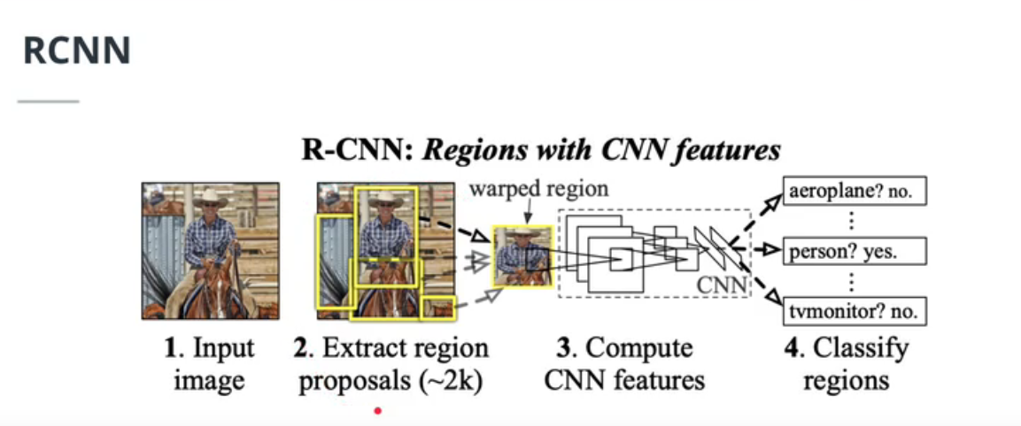

Slide 8
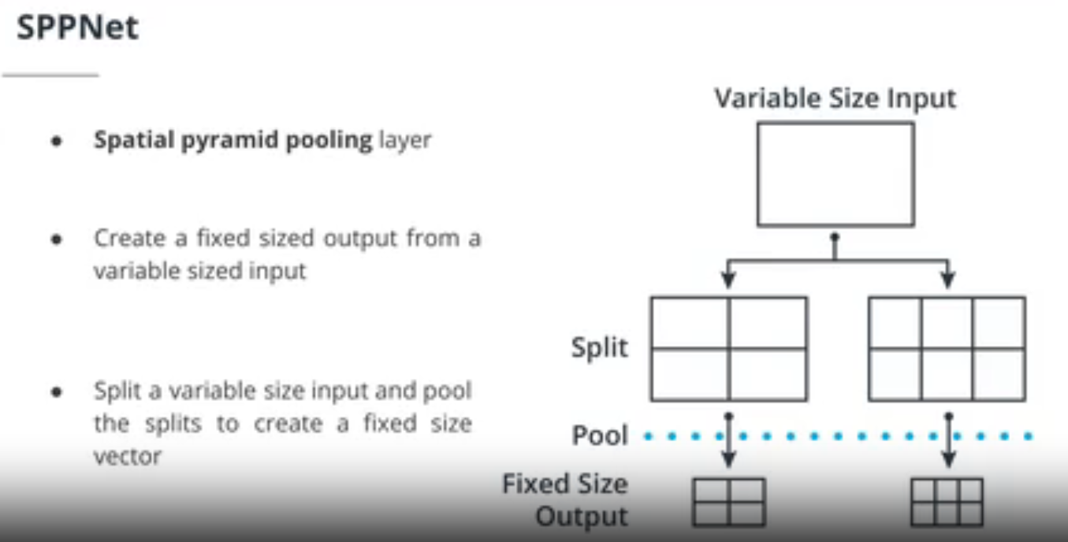
SPPNet
SPPNet(opens in a new tab) introduced a new type of layer to remediate some of the issues of the RCNN architecture: the spatial pyramid pooling (SPP) layer. This layer takes a variable size input and creates a fixed-size input.
Let's consider an example of a 4 level SPP layer with a 1x1, 2x2, 2x3 and 4x4 split. We feed a 2D array to this layer. This array will be pooled using each one of these splits, creating a vector of dimensions1x1 + 2x2 + 2x3 + 4x4 = 27. No matter the resolution of the input image, the output vector will always be a 27x1 vector.
SPPNet also takes a different approach than RCNN by reusing the CNN feature. Indeed, instead of feeding the cropped input image, the entire image is fed to the CNN and the selective search regions are used to crop the final feature maps. These regions are then fed to a SPP layer. By doing so, SPPNet gets similar performances to RCNN while improving the inference time by almost 100 times.

Slide 9
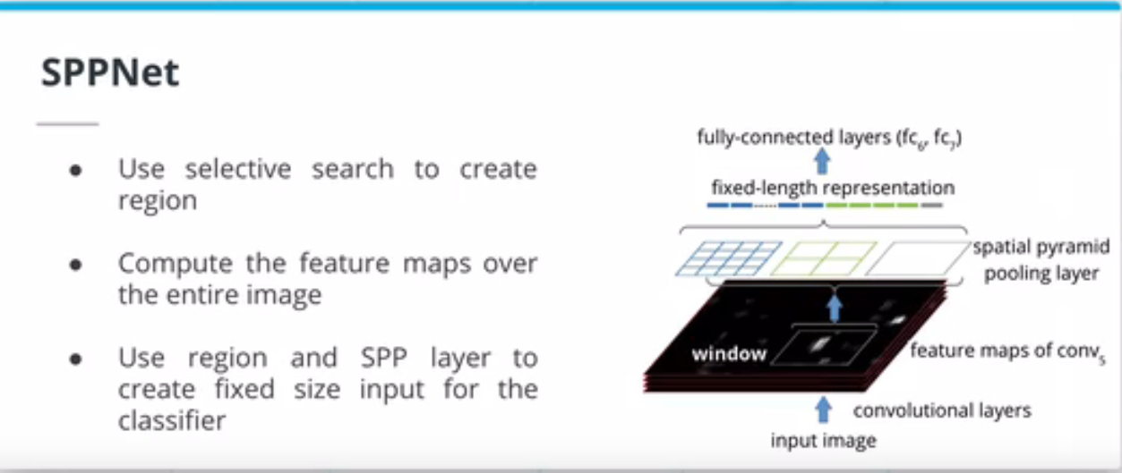

Slide 10
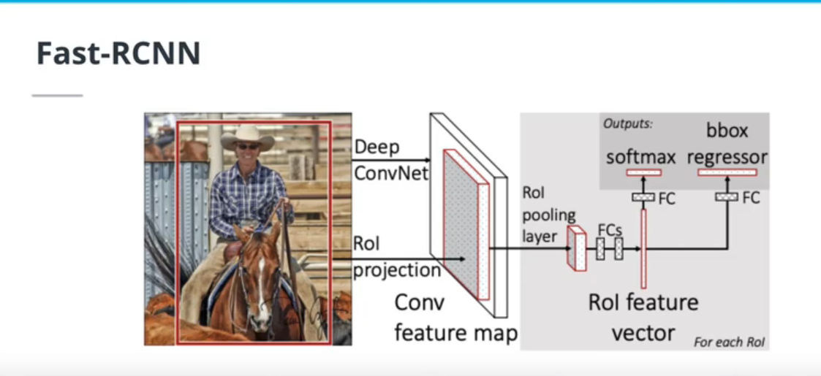
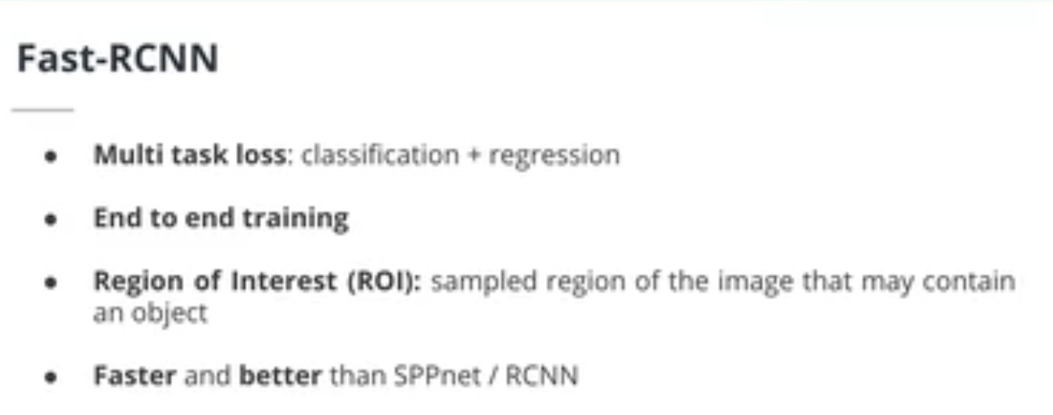
Region-Based CNNs (RCNNs) II

Slide 11
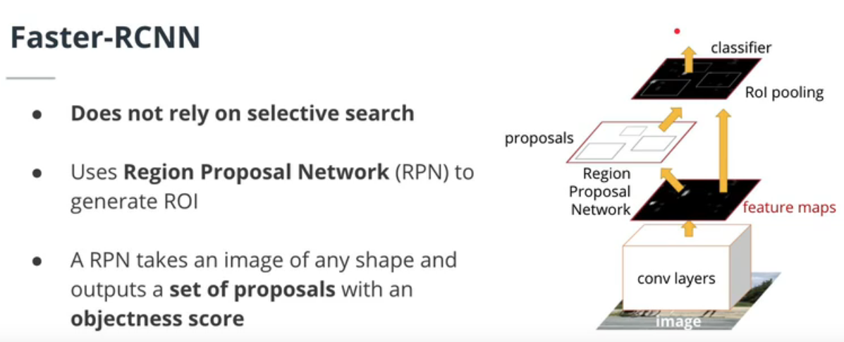
Faster-RCNN
The Faster RCNN architecture(opens in a new tab) is the latest iteration of the RCNN family.
It improves over RCNN and FastRCNN by not relying on selective search. Instead, it uses a Region Proposal Network (RPN) to generate the ROIs. The RPN uses the feature maps of the last convolution layer to generate the ROIs. The RPN uses a sliding window over the feature maps and for each position of this window, it generates k anchor boxes. These anchors boxes are used to determine if the region contains an object or not.
Thanks to a multitask loss function, all the components of FasterRCNN are trained simultaneously.

Slide 12
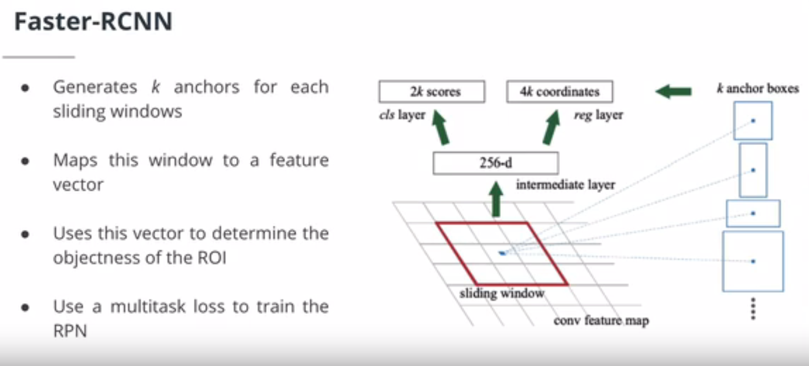

Slide 13
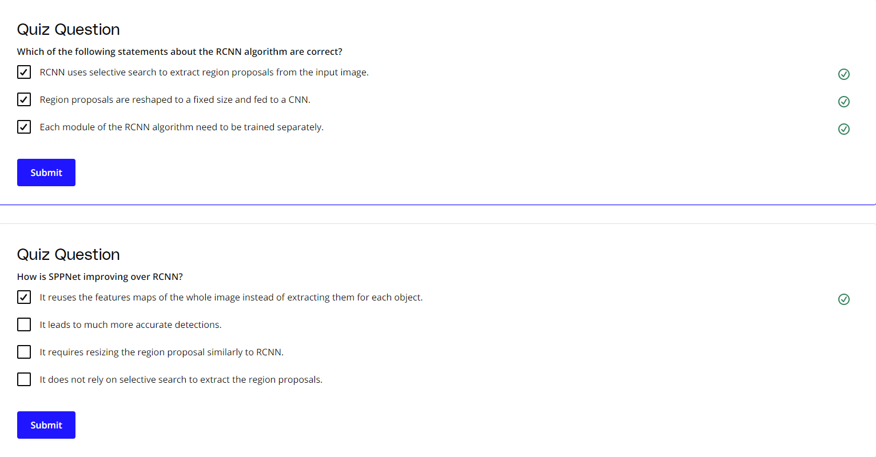

Slide 14
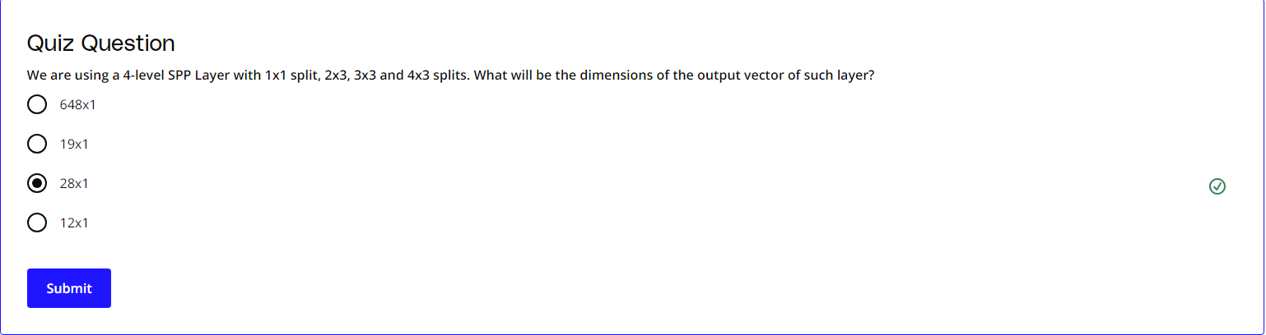

Slide 15
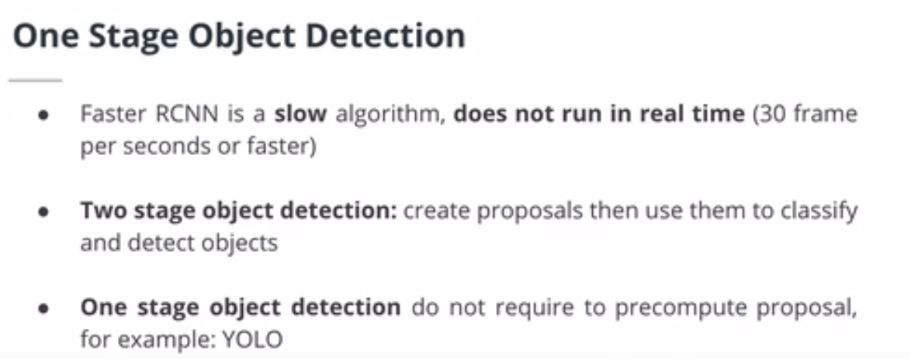
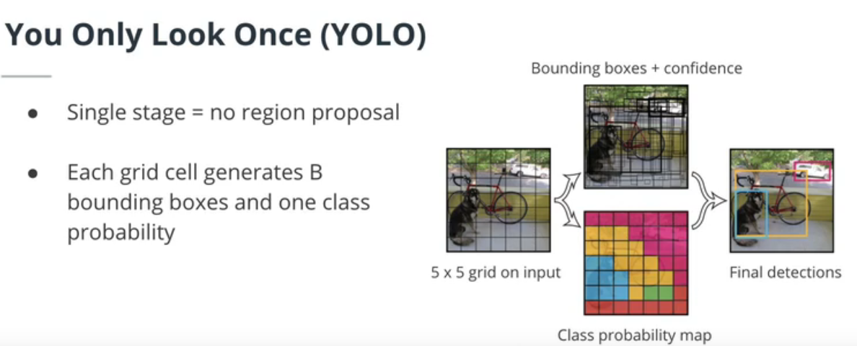
One Stage Object Detection

Slide 16
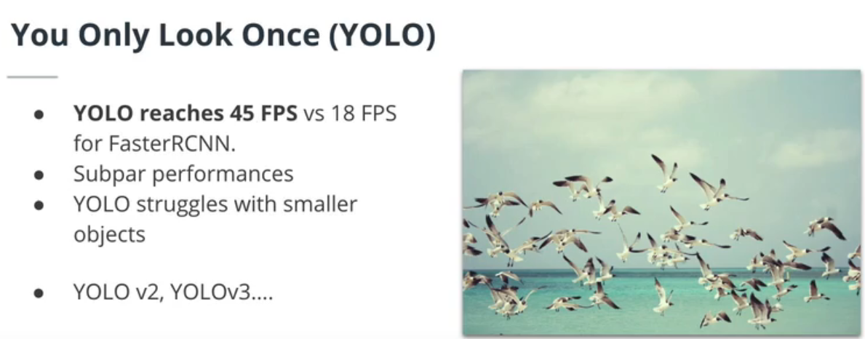
You Only Look Once (YOLO) takes a very different approach than FasterRCNN. Instead of relying on a region proposal step, the author of this 2016 paper(opens in a new tab) directly split the input image into a grid. For each element of the grid, the network predicts B bounding boxes and objectness scores.
By getting rid of the region proposal step, YOLO provides much faster inference time than FasterRCNN.
The authors released two more versions of YOLO. The latest one, YOLOv3 is described here(opens in a new tab). Moreover, other researchers published YOLOv4(opens in a new tab) and YOLOv5(opens in a new tab). YOLO remains one of the most popular object detection architectures.

Slide 17
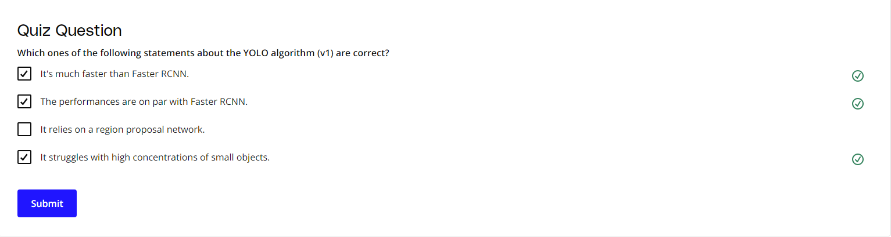

Slide 18
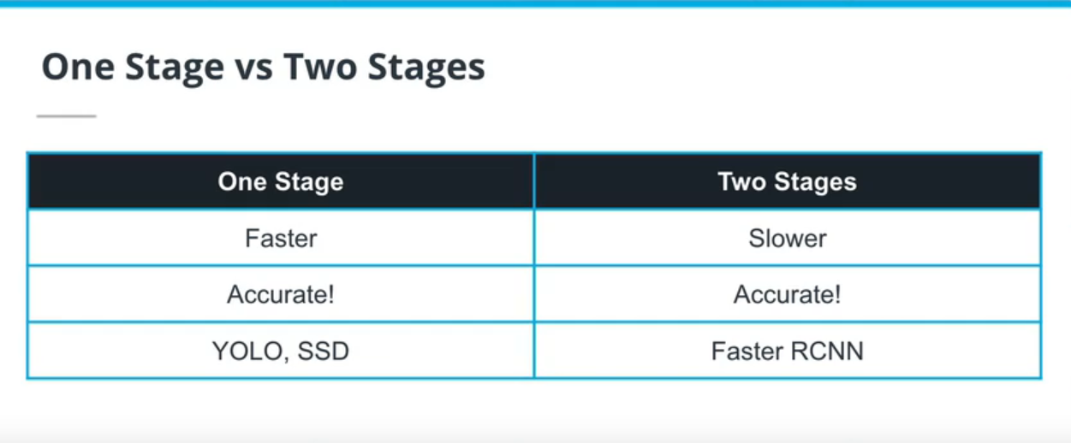
One vs Two Stages
Two stage object detection models, such as FasterRCNN, need a region proposal step to propose ROIs. These regions of interest are then classified. One stage object detection algorithms, however, do not require a region proposal step and work directly off the input image. Whereas this initially meant that one stage object detectors were faster but less accurate, recent iterations of YOLO have shown better performances than FasterRCNN.
However, FasterRCNN remains one of the most popular object detection algorithms, perhaps because of its wide availability in diverse libraries and the inertia of the industry to adopt more recent architectures.

Slide 19
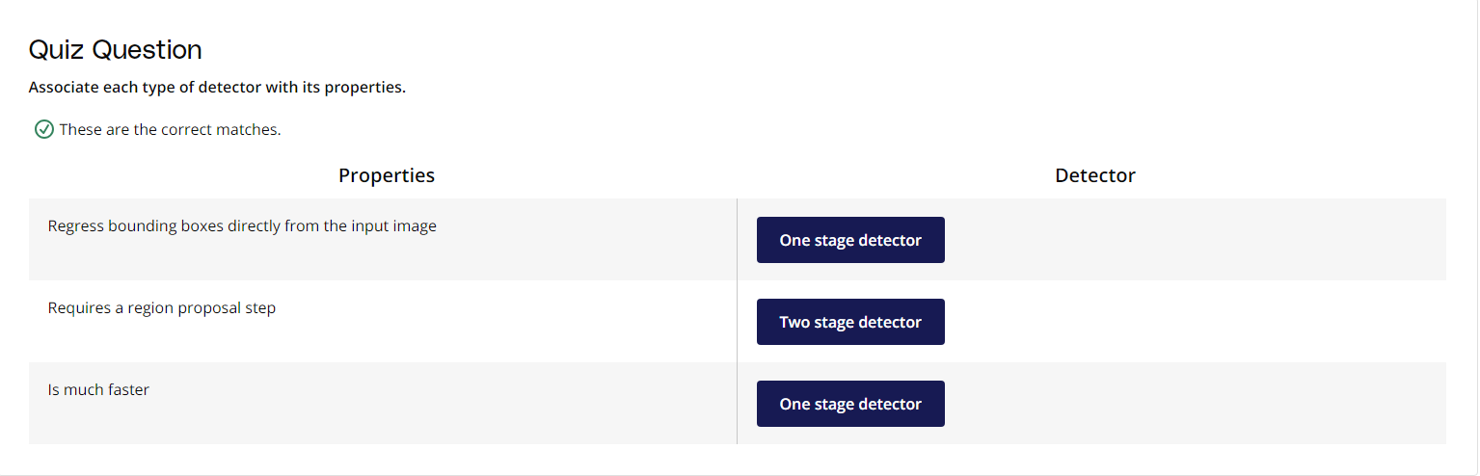

Slide 20
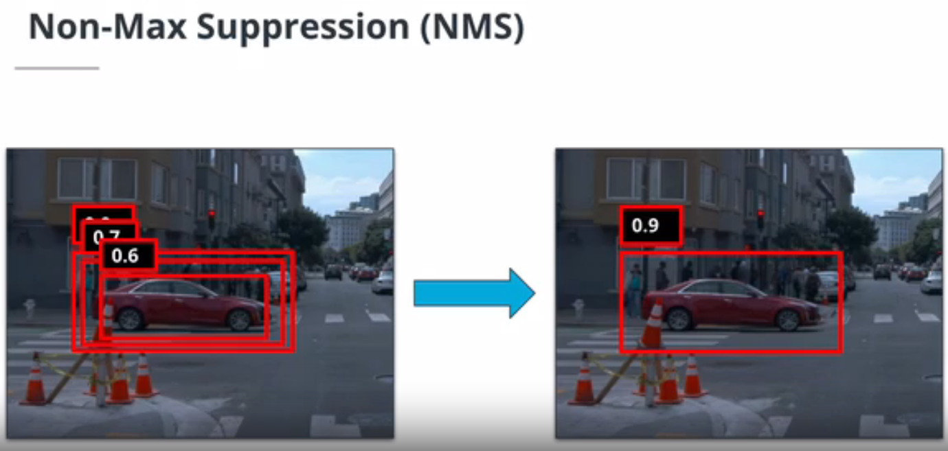
Non-Max Suppression
Non max suppression (NMS) is a post-processing methods to remove redundant detections. Remember the Region Proposal Network in FasterRCNN? For each location of the sliding window, the network generates k anchor boxes. Because of that, object detection algorithms tend to output a large number of bounding boxes. By using the confidence score of each prediction, we can clean these predictions by removing high-overlapping / lower confidence predictions.

Slide 21
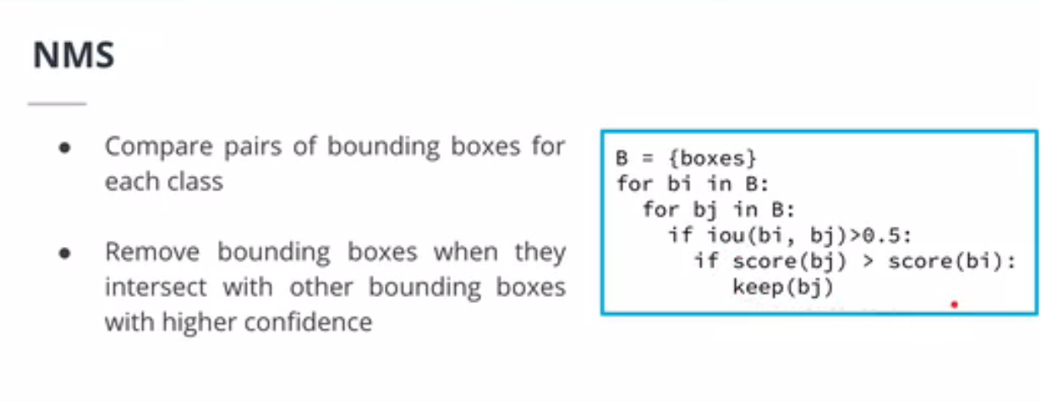

Slide 22
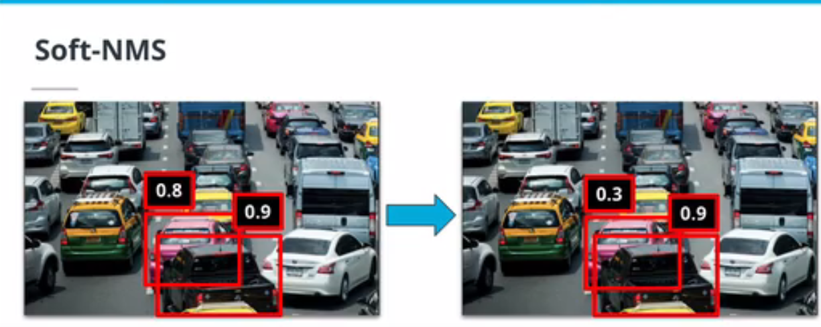
Soft-NMS
In this 2017 paper(opens in a new tab), the authors argued that NMS could actually hurt the performance of object detection algorithm by removing predictions of highly occluded objects. Instead, they proposed the Soft NMS algorithm. Soft NMS does not remove predictions that highly overlap higher confidence predictions, but instead reduces their confidence score. By doing so, Soft NMS improves the performance of object detection algorithms in dense environments.

Slide 23
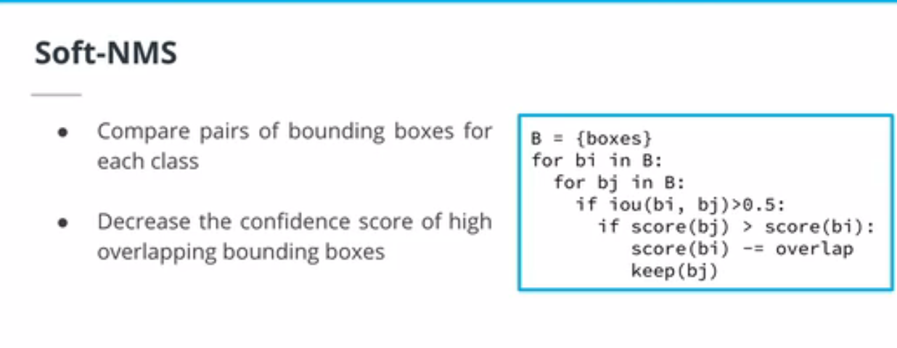
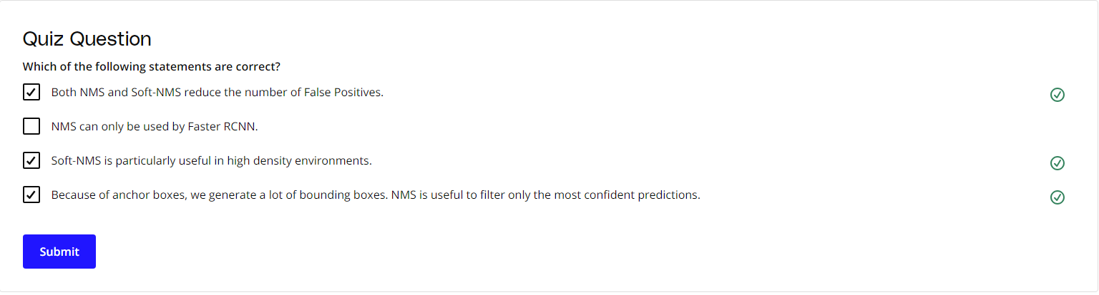

Slide 24
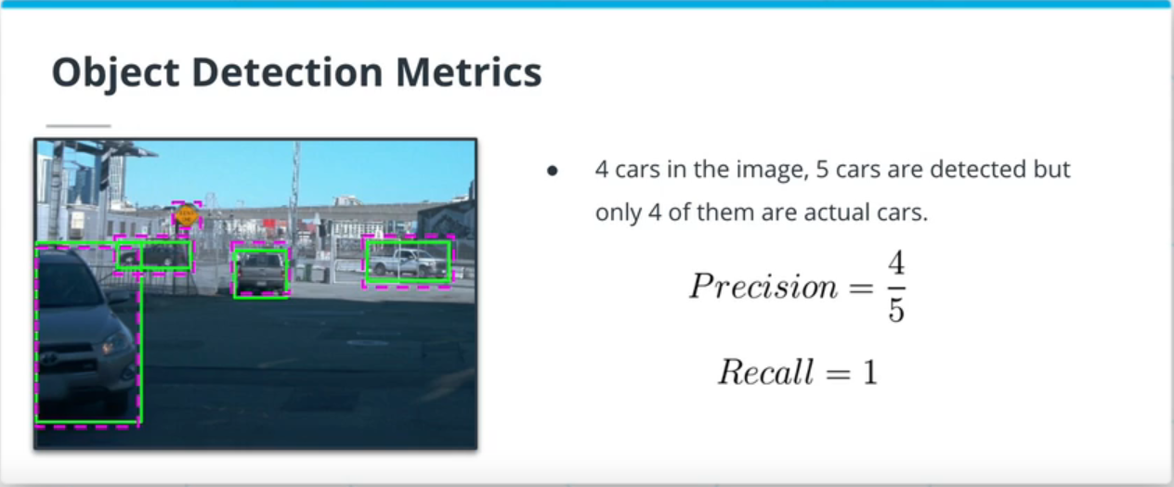
Mean Average Precision (mAP)
Mean Average Precision (mAP) is the to-go metric of the object detection task. You will find multiple variations of the mAP metric in the literature. The COCO challenge webpage(opens in a new tab) provides a good description of the different metrics. The pycocotools(opens in a new tab) Python library provides an easy way to evaluate your object detection results.

Slide 25
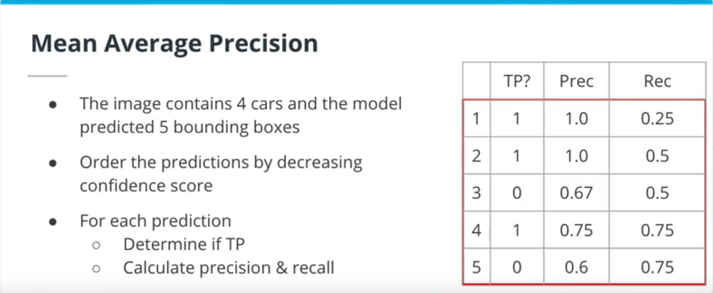
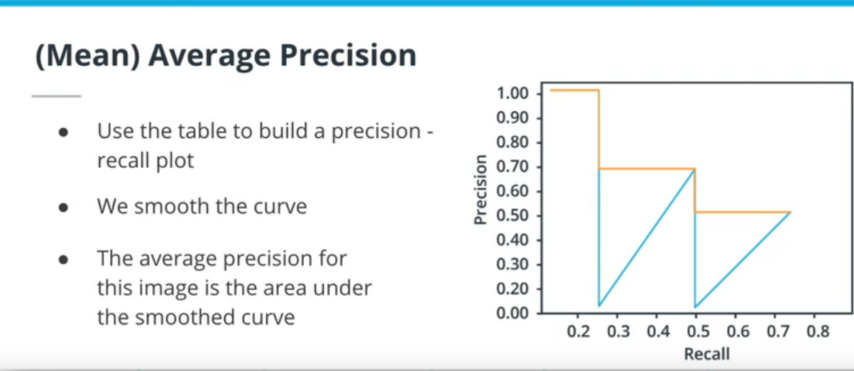

Slide 26
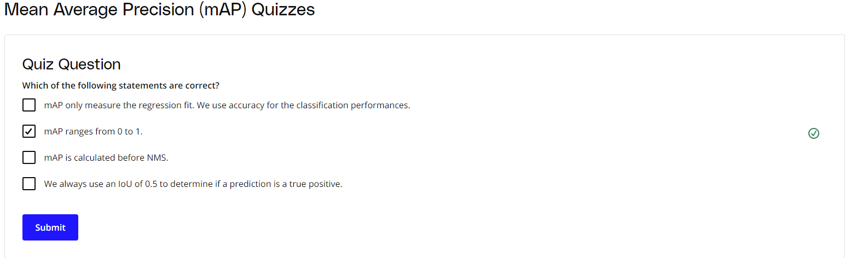

Slide 27
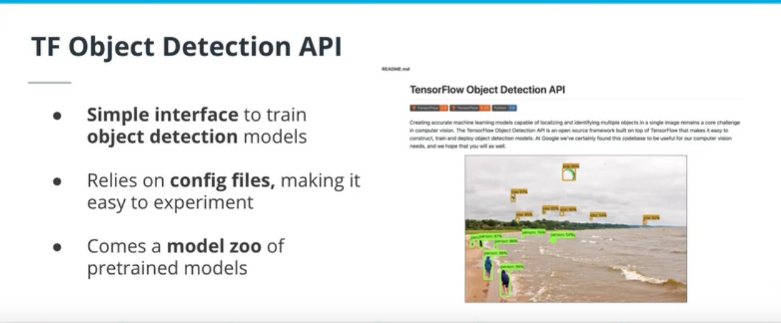
Object Detection API
The Tensorflow Object Detection API provides a simple interface to develop and train object detection models in TensorFlow. It uses a single config file to describe the entire training pipeline, including the model architecture, the different datasets and hyperparameters.

Slide 28
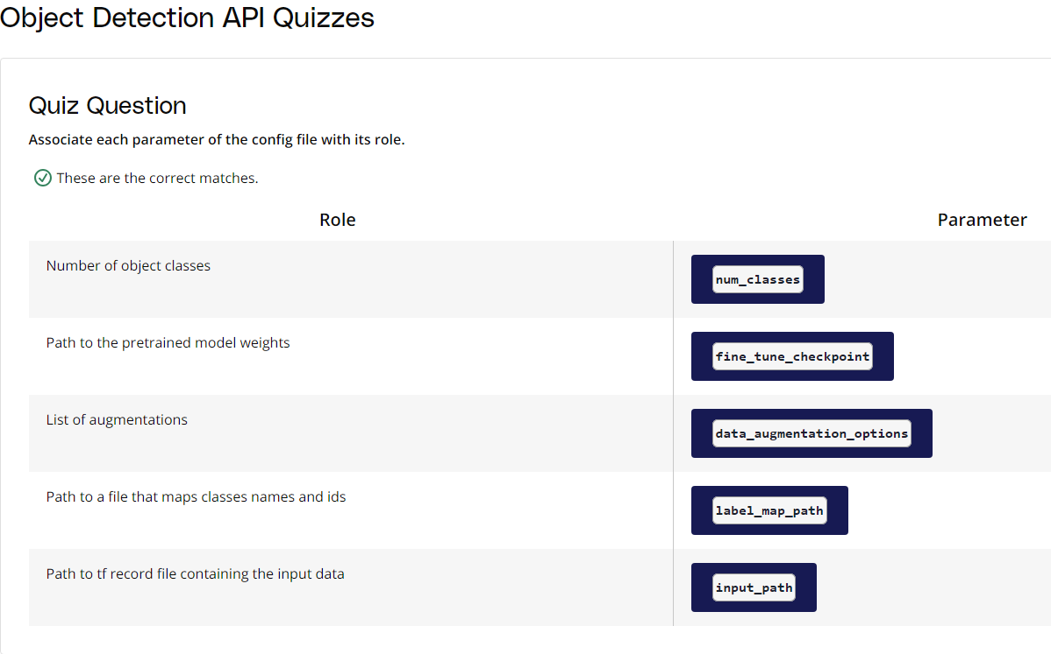

Slide 29
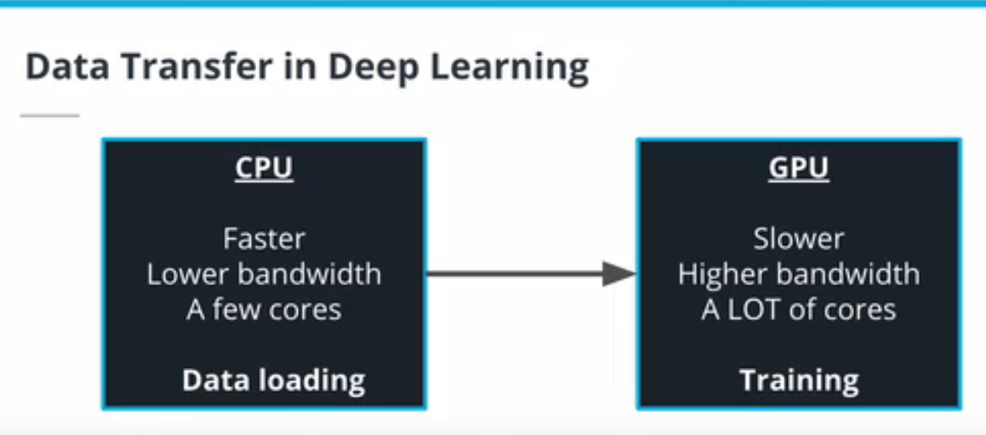
Training Tips #1

Slide 30
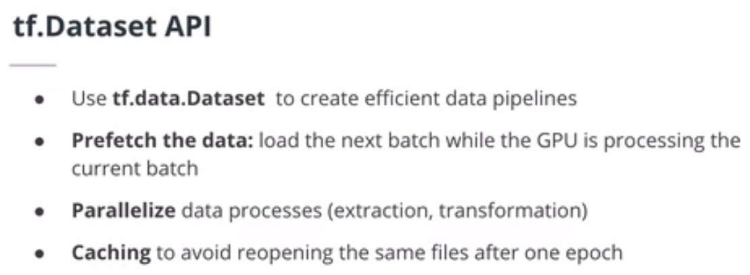
nvtop is a great, open source(opens in a new tab) tool to track the performances of your GPU. It is the GPU version of htop(opens in a new tab) and is very useful to identify any potential issues with your training pipeline.
A very common problem when training deep neural network is the GPU idling because it is not receiving data fast enough. In other words, the data is processed faster by the GPU than it is being loaded by the CPU.

Slide 31
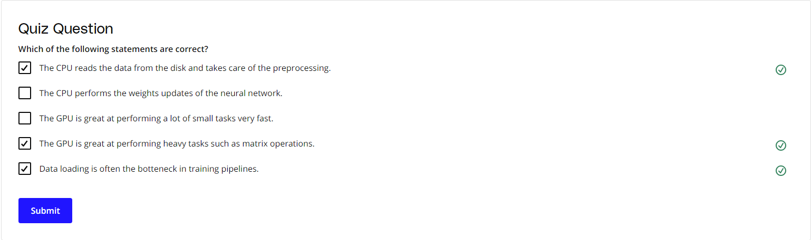
Training Tips #2
When training a NN model on a new problem, following these steps might save yourself headaches:
Become one with the data. Study and analyze your dataset in as much depth as possible
Establish baselines
Check your training pipelines
Start with a simple model and don't use any training tricks, such as learning rate annealing
Iterate based on your results
You can find an exhaustive check list to follow when training a new architecture here(opens in a new tab).

Slide 32
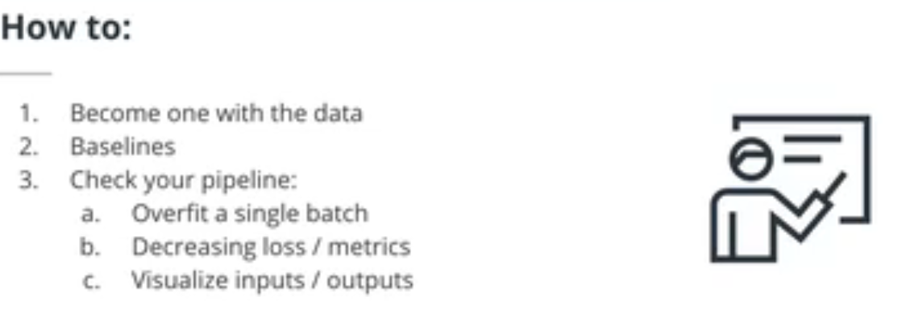
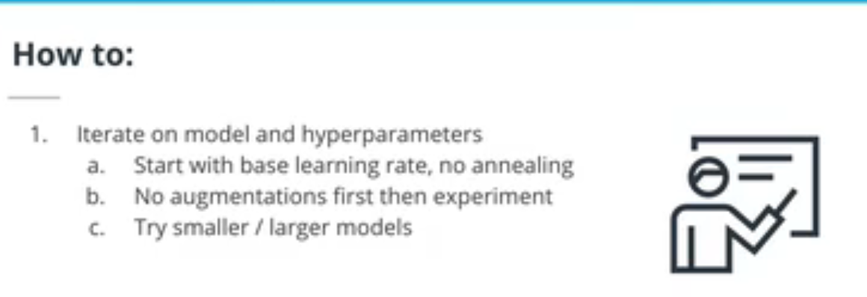

Slide 33
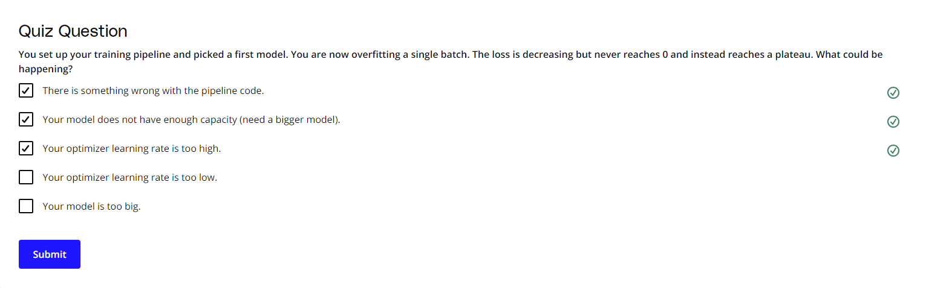
In this lesson, we tackled the following:
An overview of object detection algorithms: one and two stages object detections algorithms (RCNN family and YOLO)
A post processing method for detections: NMS and soft NMS
A new metric: mean average precision and how to calculate it
The TensorFlow object detection API: a framework to train object detection algorithm with TensorFlow
Tips and tricks to train and monitor NN: how to leverage different tools and a recipe to follow when training new architectures

Slide 34
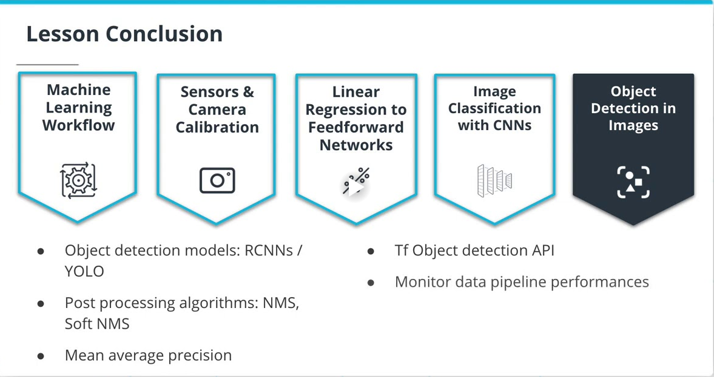

Slide 35
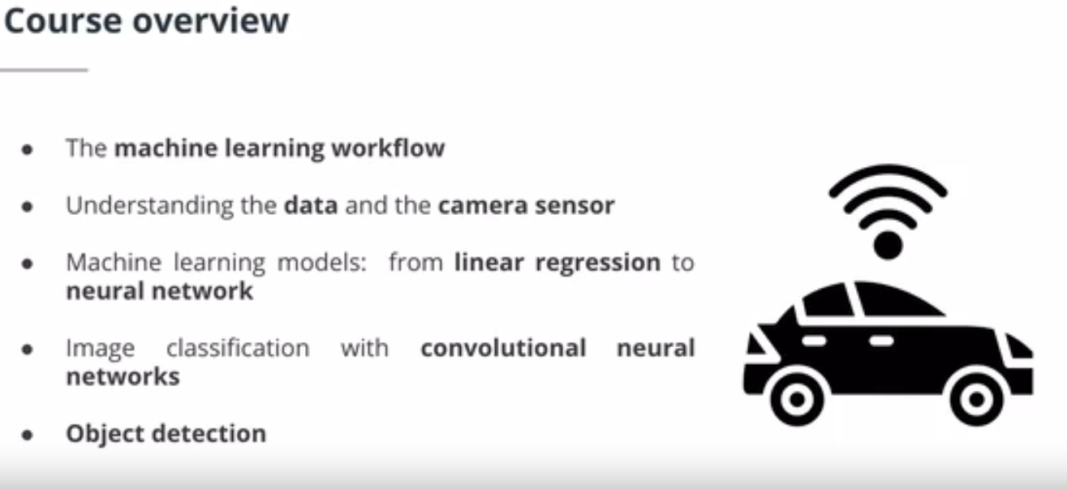

Slide 36
THE END

